Slide 1


Visions 2021 & 2041, Golden Ladders 2071 & 2100 & Journey to SDGs 2030 including their health ingredients: what they really mean for Bangladesh and how this nation is moving to these high end futures
MD. ABUL KALAM AZAD
Principal Coordinator (SDG)
Prime Minister’s Office
23 October 2018

Slide 2
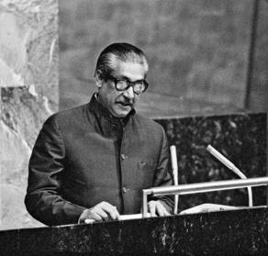
“Let us together create a world that can eradicate poverty, hunger, war and human sufferings and achieve global peace and security for the well- being of humanity”
Bangabandhu Sheikh Mujibur Rahman
Father of the Nation of Bangaladesh 25 September 1974, UNGA
10/24/2018
2

Slide 3
Development Miracle
Issue | 2008 | 2018
GDP of Bangladesh ( billion USD) | 91 | 280
Per Capita GDP (USD) | 615 | 1752
Poverty Rate | 40 (2005) | 22
Maternal Mortality (Live Birth per Thousand) | 3.48 | 1.72
Literacy Rate | 54 | 73
Life Expectancy (Year) | 69 | 72
Foreign Ex. Reserve (billion USD) | 7 | 32
Export (billion USD) | 16 | 35
Import (billion USD) | 23 | 44
Electricity Generation Capacity | 3,264 MW | 20,133 MW
10/24/2018
3

Slide 4
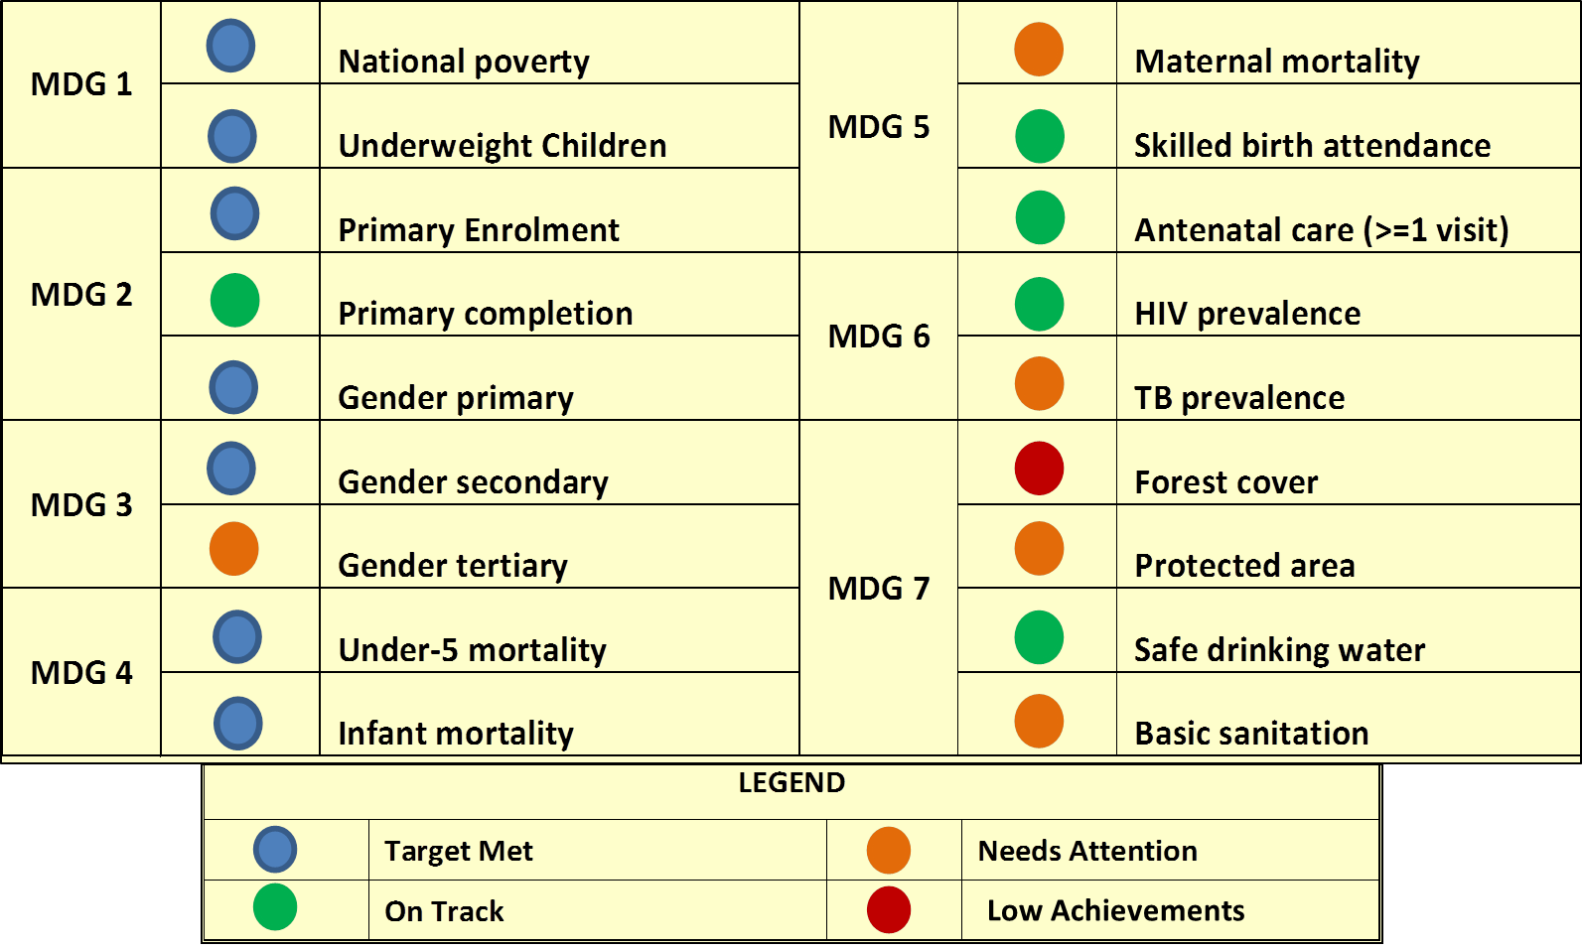
MDG Score Card Bangladesh
10/24/2018
4

Slide 5
Bangladesh MDGs achievements
International recognition
Hon’ble Prime Minister of Bangladesh was awarded with ‘UN MDG Awards 2010’ for reducing under five child mortality rate (MDG-4).
Bangladesh received South-South Award 'Digital Health For Digital Development' for success on attainment of MDG- 4 & MDG-5.
Bangladesh received ‘Diploma Award’ from FAO for achieving the MDG-1.
Bangladesh was honoured with the ‘special recognition’ for outstanding progress in fighting hunger and poverty.
Bangladesh was awarded ‘South-South Award’ for achievements in alleviating poverty.
Hon’ble Prime Minister was awarded ‘UNESCO Peace Tree Award’ for her commitment to women’s empowerment and girls’ education.
5

Slide 6
Bangladesh MDGs achievements:
International recognition
Bangladesh received ‘Women in Parliaments Global Forum Award’, as
Bangladesh ranked 10th out of 142 countries in the political sphere.
Hon’ble Prime Minister was awarded “Champions of the Earth” by UNEP for
Policy Leadership.
The UN-Women recognised our Hon’ble Prime Minister as "Planet 50-50 Champion"
The Global Partnership Forum awarded Hon’ble Prime Minister "Agent of Change Award" for her outstanding contributions to women empowerment.
‘International Achievement Award’ and the ‘2018 Special Distinction Award for Outstanding Leadership’ for her humanitarian and responsible policy in hosting the Rohingyas
6

Slide 7
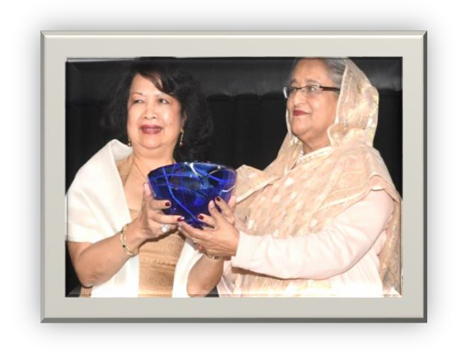
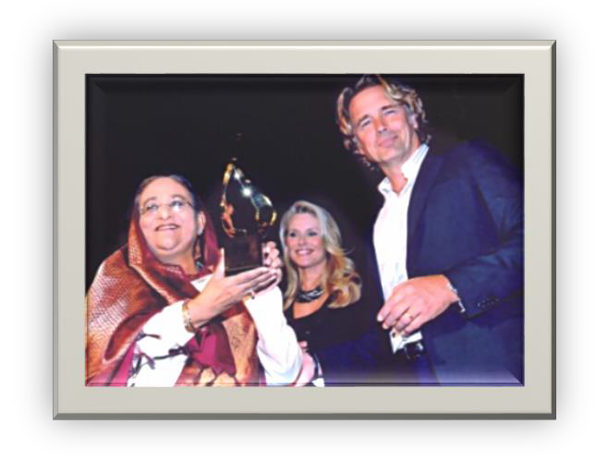
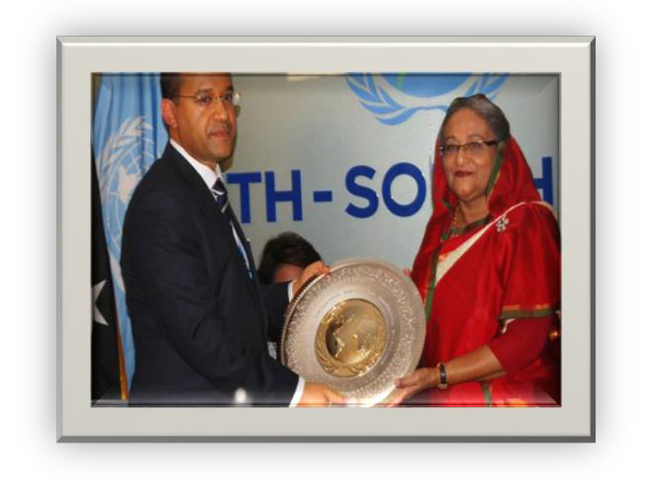
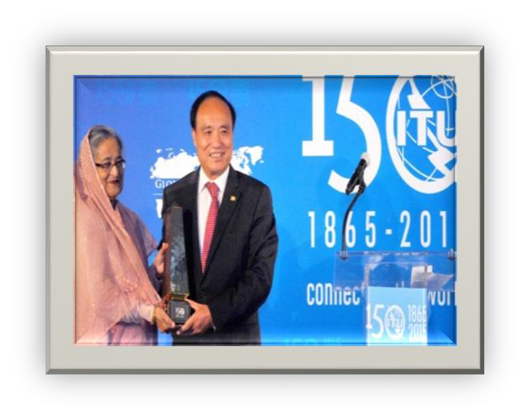
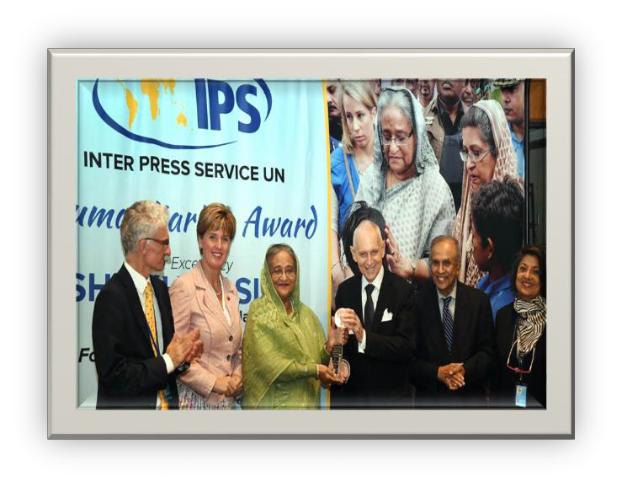
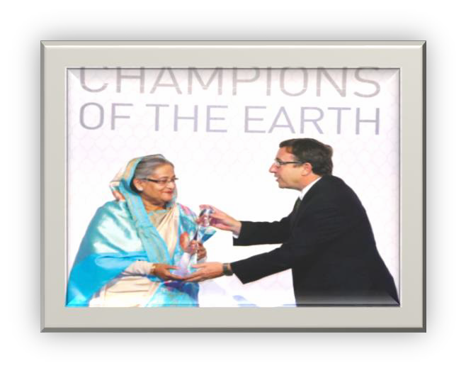
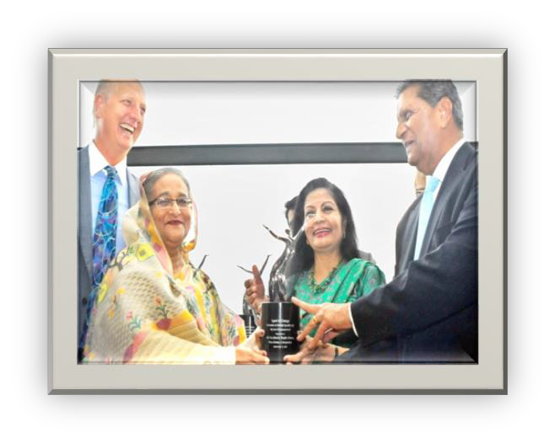
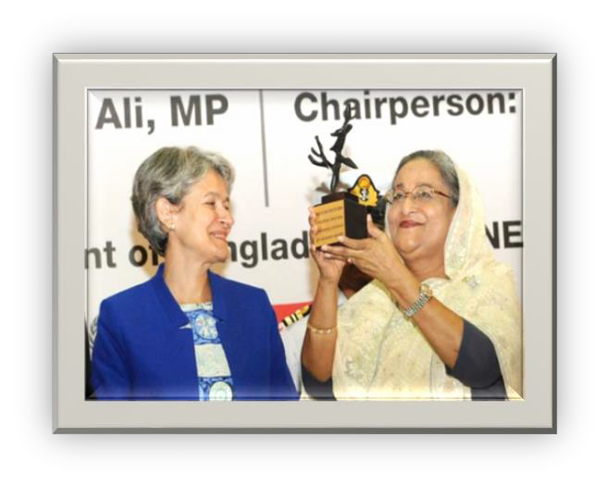
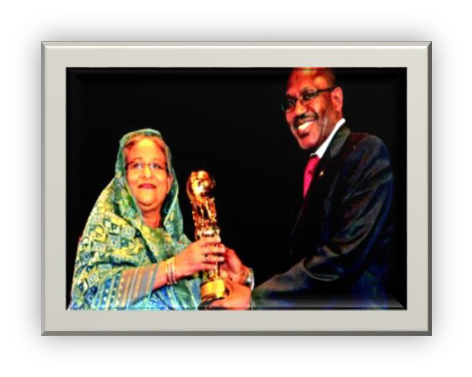
10/24/2018
7

Slide 8
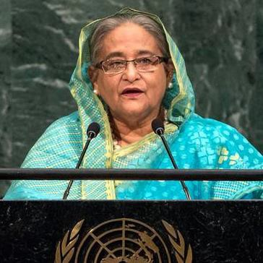
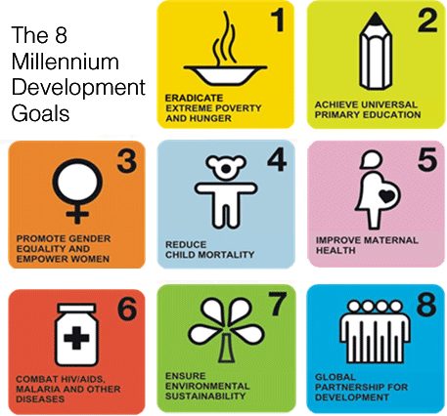


“ I am confident that Bangladesh could show its capacity in achieving SDGs the way it achieved the MDG goals.”
Hon’ble Prime Minister
Sheikh Hasina
10/24/2018

Slide 9
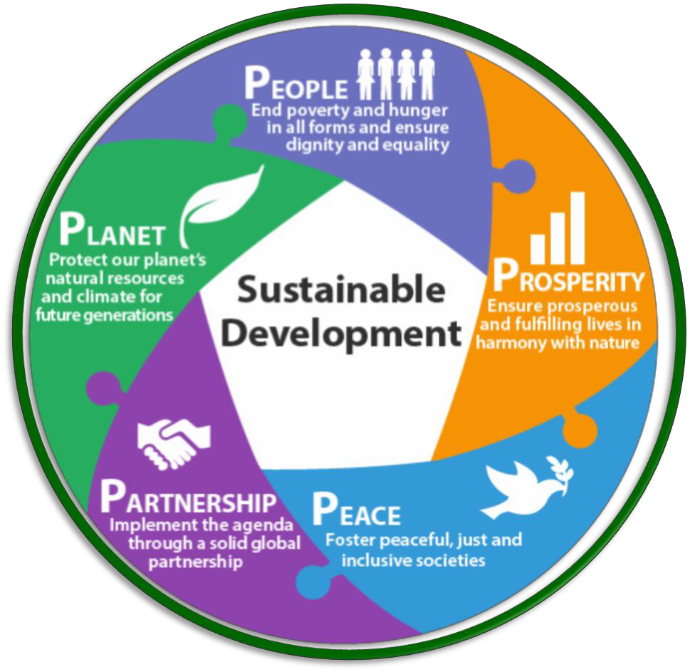





SDG Basics
LEAVING NO ONE BEHIND
232
indicators
169 targets
17 goals
SDGs
PUT SUSTAINABLE DEVELOPMENT AT THE CORE
10/24/2018

Slide 10
Leaving No One Behind
Youth
Women and Children
Elderly people
Tribal
Transgender
Autistic and children with special needs
People in Island and Haor
Other backward section
10/24/2018

Slide 11









SDG Implementation Strategy
NGOs
Professional
groups
CSOs
Whole of the society
Businesses
DPs
women
network
Media
10/24/2018

Slide 12

Alignment of SDGs with 7FYP
Policy Assistance
SDGs are aligned with
Annual Plan
SDG targets are included in the
₇th
the FYP
(2016-
National
2020), the
Development Plan of
Bangladesh.
Annual Performance Agreement (APA)
56 SDG targets are directly reflected into 7th FYP
102 targets are almost
similar
10/24/2018

Slide 13
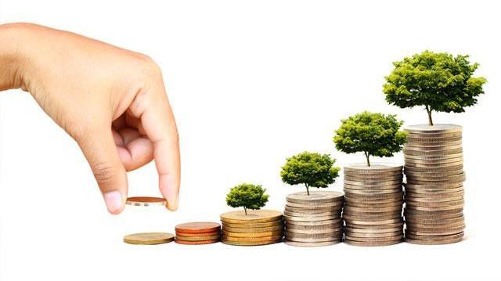
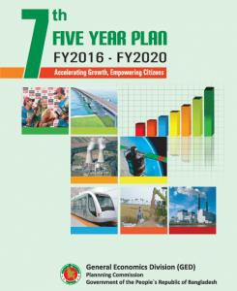
the Agenda 2030 (SDGs)
Initiatives of GOB in mainstreaming
Implementation
9th FYP
FY 2026 –2030
8th FYP
FY2021 – 2025

Slide 14




Actions
implementation and Monitoring committee
Translation of
Documents
SDG Tracker
M & E Framework
Mapping of Ministries
The Process of Implementation
Localization of SDG
Action Plan
Training Handbook on 7th FYP
Resource Gap
Analysis
Data Gap Analysis
10/24/2018
14

Slide 15
SDG Implementation and Monitoring Committee
Involve all stakeholders: SDG Implementation and Review
Committee
Creation of a dedicated office (Principal Coordinator for SDGs Affairs) at PMO.
General Economics Division (GED) of Planning Commission is the secretariat for the committee.
10/24/2018
15

Slide 16


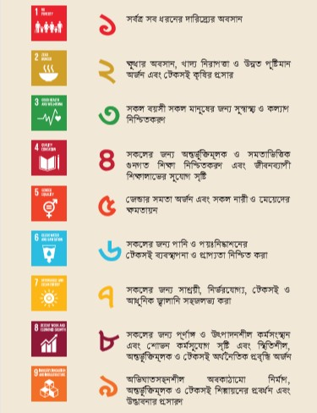
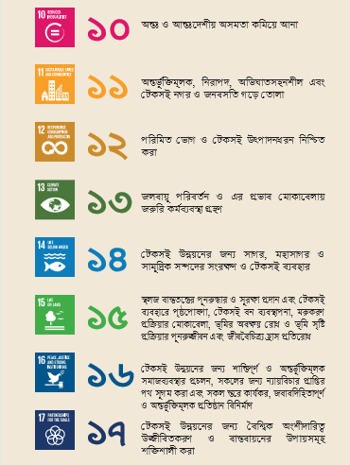
Translation of Documents
10/24/2018
16

Slide 17
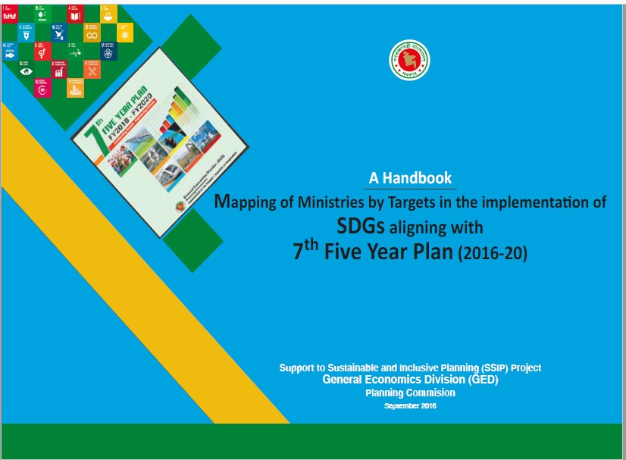
Mapping of Ministries/Divisions by SDG Targets
70
61
60
50
43
40
34
30
20
10
SDGs Mapping
among the
been
0
Lead
Co-lead
Associate
Ministries/ Divisions has
finalized and published
17
10/24/2018

Slide 18
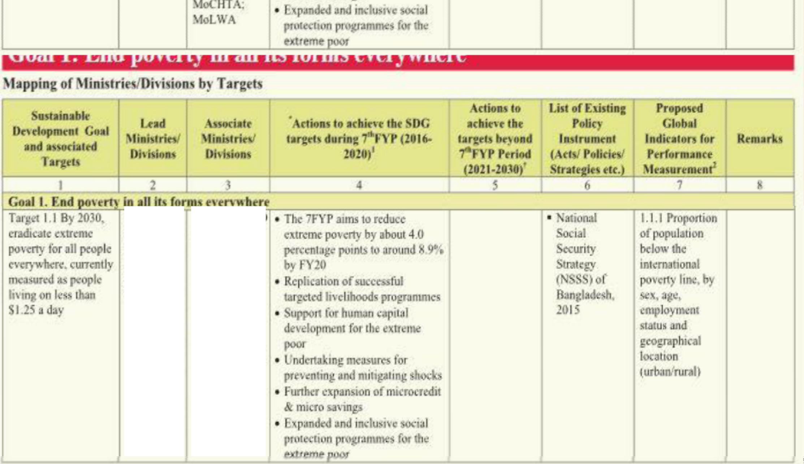
Lead:
CD
(leading the NSSS);
Co- Lead: GED (as NPFP)
ERD;FD; BFID(BB): LGD;MoA; MoF; MoDMR; MoEWOE; MoFL;
MoInd; MoLE; MoSW; MoYS; PMO; RDCD; SID; MoWCA, MoCHTA; MoLWA
10/24/2018

Slide 19
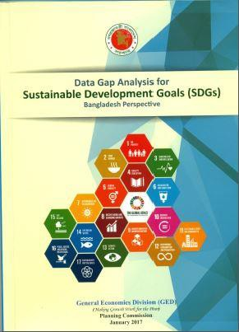
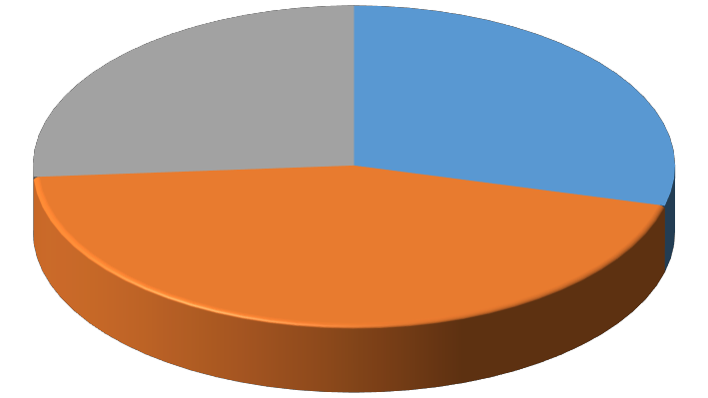
Data Gap Analysis for SDGs Monitoring
Availability of Data
63
70
108
Full
Partial
Not available
10/24/2018

Slide 20
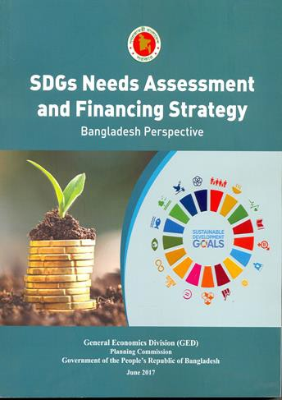
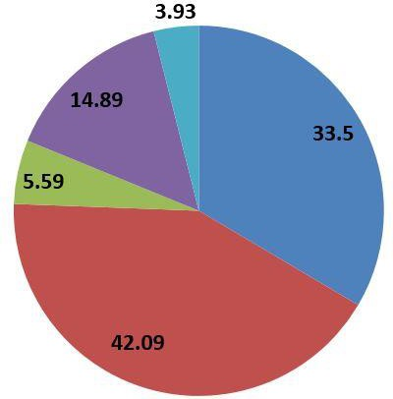
Financing for SDGs: Bangladesh
US$ 3-5 trillion annually throughout
the world.
In Bangladesh, 928 Billion US$ additional funding required. Annual 66 billion US$
Public (%) Private (%) PPP (%) NGOs (%)
External Sources (%)
10/24/2018
20

Slide 21
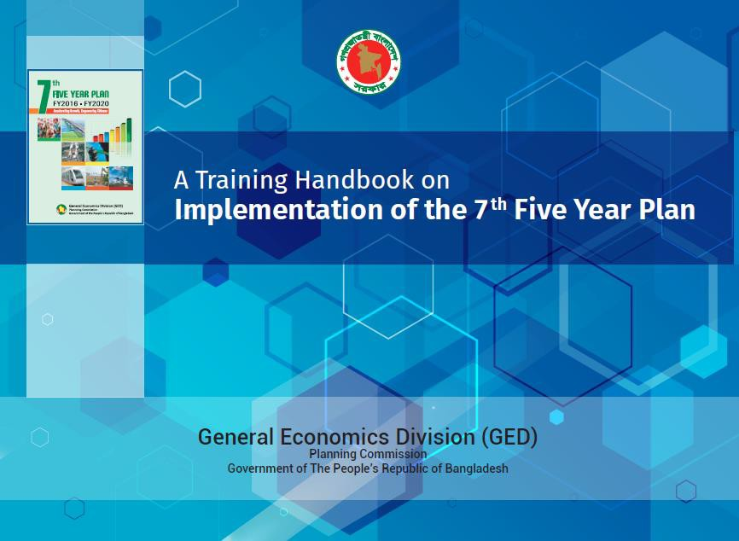
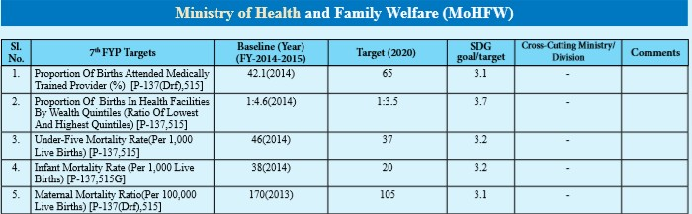
A Training Handbook on 7th Five Year Plan
10/24/2018
21

Slide 22
SDG LOCALIZATION
Massive awareness programme at the grassroots
Workshops at Divisional and District levels have
been conducted
SDGs indicators have been prioritised
Local level people would fix the target and prepare
corresponding action plan to implement SDGs
10/24/2018

Slide 23

M & E Framework of SDGs
10/24/2018

Slide 24
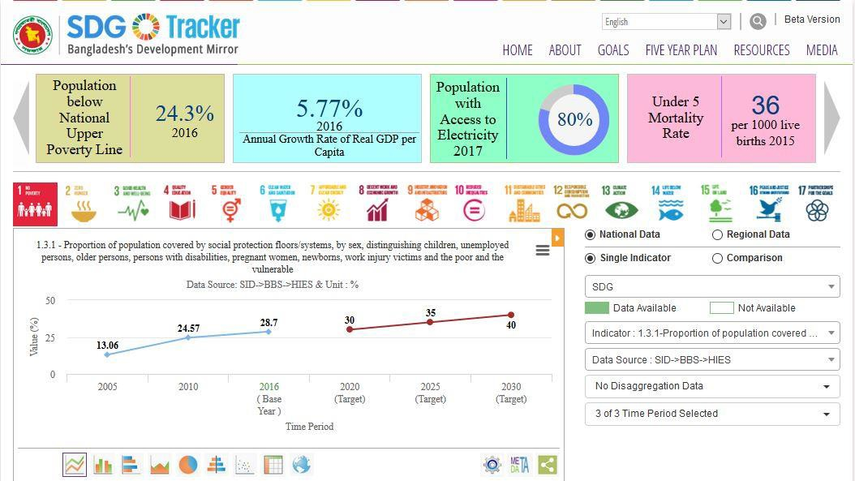
SDG TRACKER
An online SDGs Data Repository (SDG Tracker) system has been developed.
It allows tracking of each goal and target, indicator by indicator.
10/24/2018

Slide 25


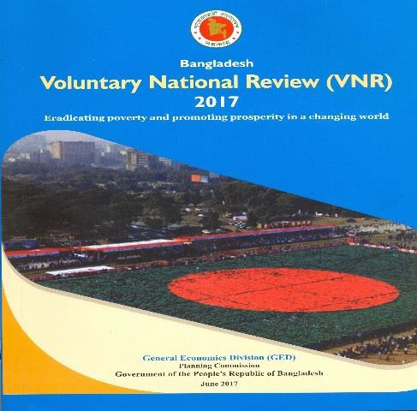
Voluntary National Review 2017
Bangladesh has participated in the Voluntary National Review (VNR) along with 42 countries
The focus of the report is where we are in implementing Agenda 2030.
25
Seven goals were reviewed: Goal 1 (Poverty)
Goal 2 (Hunger)
Goal 3 (Health)
Goal 5 (Gender)
Goal 9 (Infrastructure)
Goal 14 (Life below water)
Goal 17 (Means of implementation)
10/24/2018

Slide 26
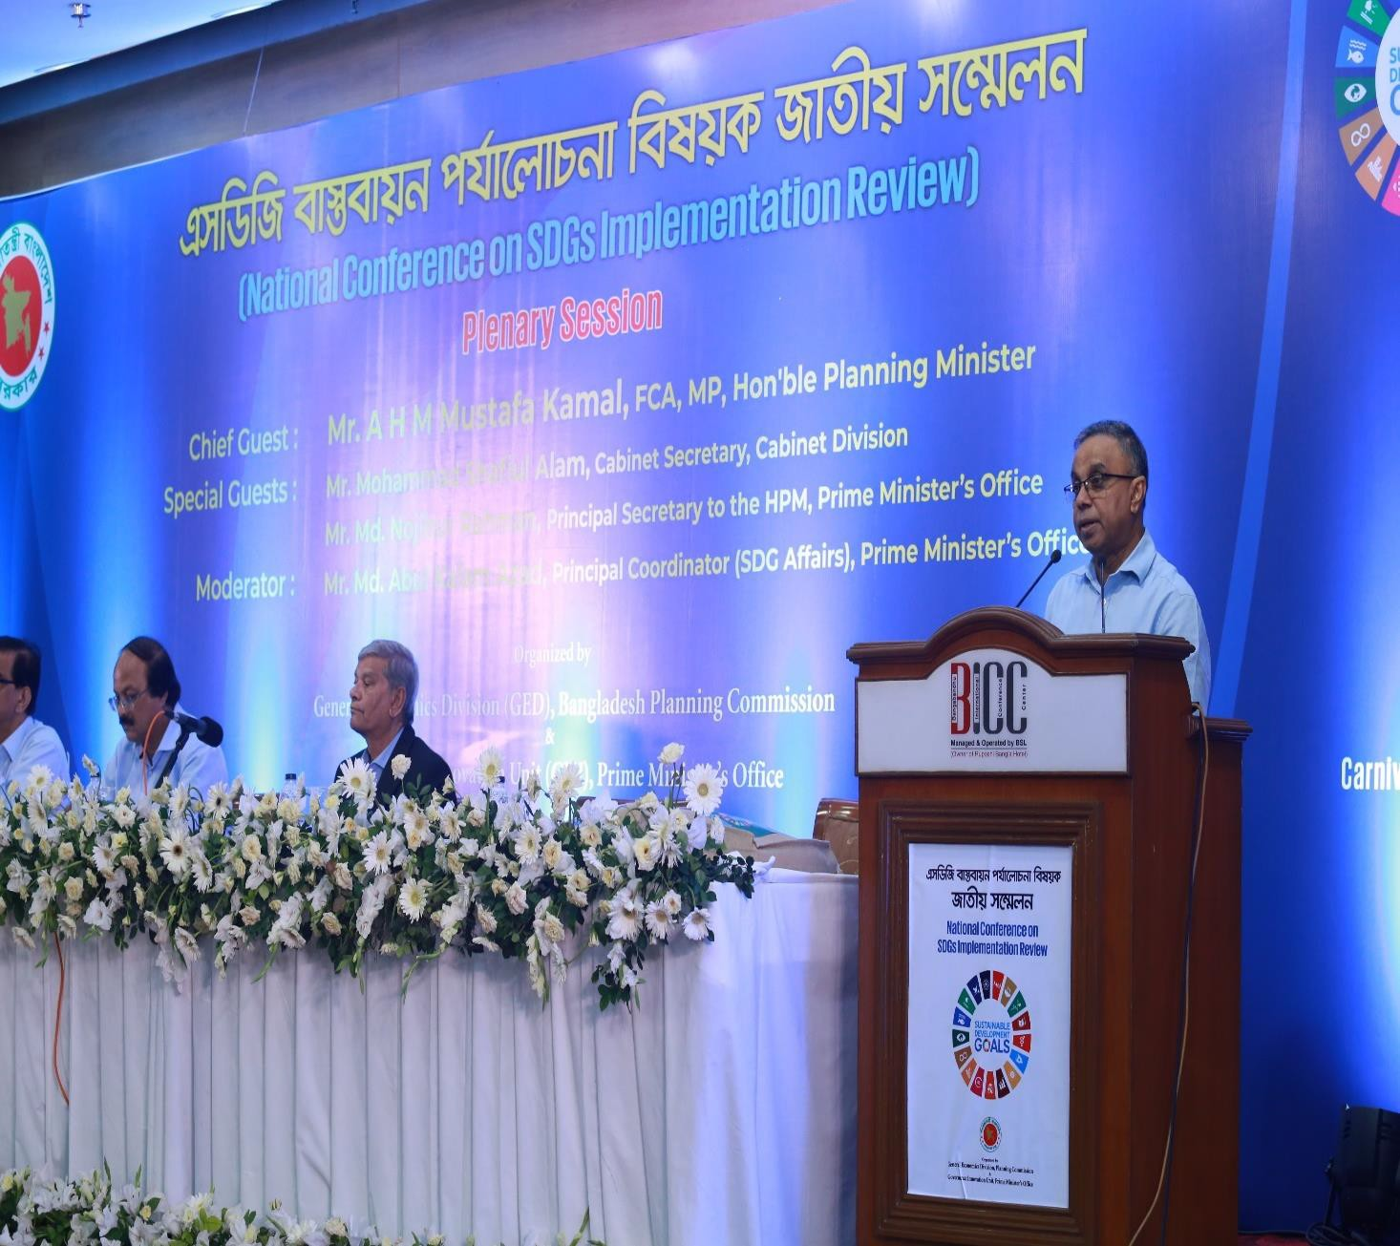
Government in Action: SDGs Implementation Review
High level coordination mechanism representing institutions of the public and private sector and different stakeholders established.
On 4th to 6h July 2018 around 2000 participants from Government, NGOs, DPs, Private sector, Academia, media, CSO etc. participated in the SDGs Implementation Review (SIR) Conference.
These mechanism include both data and qualitative assessments on progress and challenges of SDGs.

Slide 27



























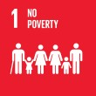


Sheikh Hasina Special Initiatives and SDG
Women
Empowerment
Electricity for all
Ashrayan
Project
Social Safety Net Programme
Education Assistance Trust
Vision 2021: Hunger & Poverty Free Bangladesh
Environment
Protection
Ekti Bari Ekti Khamar
Investment
Development
Digital Bangladesh
Community Clinics
27

Slide 28







Challenges Ahead
Resource Mobilization
Skill development and quality education
Strengthen international development cooperation and building
effective partnership
Natural disasters and climate change
Over 1.1 million Rohingya
SDGs localization by Government, INGOs and NGOs
10/24/2018

Slide 29










Way forward
Increased Investment in human development
Overcoming infrastructure gap 100 EZs and Hi-tech Park
One Stop Service
Ease of doing business
Quality education, skill development and research
Innovation, digitalization and one stop service
Improving governance
Increasing Female labor force participation Diversification of export
10/24/2018

Slide 30
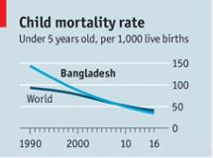
Phenomenal success in Health Sector
Bangladesh shows how to keep children alive
Life Expectancy has increased 30
years in last 47 years
Stunting has reduced 37.5
percentage points in last 23 years
69.0
72.8
73.6
64.2
66.8
54.8
56.1
42
53.2
43.2
41.3
36.1
1971 1981 1991 2001 2008 2011 2018
1991 2001 2007 2011 2014
In 1990 the under-five death rate in Bangladesh was 54% higher than the world average. Now it's 16% lower (2016): Economist
In last one decade life expectancy
has increased 6 years
Though a huge success, it is still
a challenge
Total Fertility Rate (TFR) has reduced significantly
from 6.3 in 1975 to 2.05 in 2017

Slide 31
1.a.2 Proportion of total government spending on essential services (education, health and social protection)
    Prevalence of stunting among children under 5 years of age
    Prevalence of malnutrition among children under 5 years of age, by type (wasting and overweight)
4.2.1 Proportion of children under 5 years of age who are developmentally on track in health,
learning and psychosocial well-being, by sex
Target 5.6: Ensure universal access to sexual and reproductive health and reproductive rights as agreed, in accordance with the Programme of Action of the ICPD and the Beijing PFA and the outcome documents of their review conferences
Target 6.2: By 2030, achieve access to adequate and equitable sanitation and hygiene for all and end open defecation, paying special attention to the needs of women and girls and those in vulnerable situations
8.8.1 Frequency rates of fatal and non-fatal occupational injuries, by sex and migrant status
11.5.1 Number of deaths, missing persons and directly affected persons attributed to disasters per 100,000 population
13.1.1 Number of deaths, missing persons and directly affected persons attributed to disasters per 100,000 population
Health Sector in SDGs

Slide 32
Challenges in the Health Sector
Ensure Universal Health Coverage (UHC)
Stunting of children under Five
Low Institutional Delivery
High rate of C-Section
Quality of care
Hospital waste
management
Frequent Road Traffic Accident
Quality of drug
Operationalization of Health insurance
Drowning of children
High out of pocket expenditure
Absenteeism of care providers

Slide 33

Questions Before Us
Are we providing health service with full potential?
Are the patients satisfied with health service?
Number of Doctor and Nurse sufficient?
What’s about Carrier Planning of Doctors?
Health infrastructure?
Incentive for health officials?
Referral system? GP system?
How to stop health tourism from Bangladesh?

Slide 34









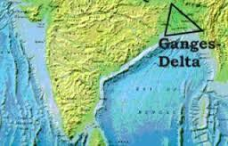









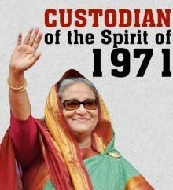



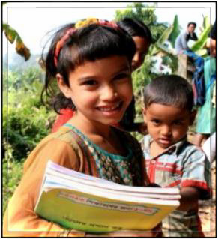




Dream Trajectory of Bangladesh
Resilient
Delta
Prosperous
Nation
Developed
Junction
DEPENDS
on our ability to translate the vision
Middle Income Country
2100
Delta Plan
2071
100 YEARS of
INDEPENDENCE
2041
Developed Country
SDGs 2030
VISION 2021
34

Slide 35
Thanks!!
10/24/2018
35

